Slide 1
INTERNET OF THINGS
TRAFFIC MANAGEMENT SYSTEM
Batch Members
1. JEYASEELAN V 951321205021
2. DUSHYANTH C 951321205011
3. ALAN ABISHEK J 951321205006
4.T.SIVA 951321205306
5.M.MARISATHISH 951321205029
MENTOR :

Slide 2
BATCH DETAILS
TEAM NAME : TECH ARMY
SI.NO | REG NO | NAME | EMAIL ID | CONTACT NO
1 | 951321205021 | V.Jeyaseelan | js8280438@gmail.com | 9786904645
2 | 951321205011 | C.Dushyanth | dushyanthark66@gmail.com | 9585426185
3 | 951321205006 | J.AlanAbishek | alanabishek085@gmail.com | 9488361226
4 | 951321205029 | M.MariSathish | massmari549@gmail.com | 7339078038
5 | 951321205306 | T.Siva | avissiva2309@gmail.com | 9791547469

Slide 3
INTRODUCTION
Traffic congestion is a severe problem in many major cities across the world.
We developed a traffic control system, which can measure both traffic load and emergency vehicles.
We implemented a sensor network work which is used to detect the traffic density.
A RF based communication system is used for getting information from the emergency vehicle.

Slide 4
BLOCK DIAGRAM
POWER SUPPLY UNIT
PIC16F877A
TRAFFIC LIGHT 1
TRAFFIC LIGHT 2
IR SENSOR NODE 2
DATA ENCODER
TRAFFIC LIGHT 3
IR SENSOR NODE 1
TRAFFIC LIGHT 4
IR SENSOR NODE 3
IRF TRANSMITTER
DECODER CIRCUIT
IR SENSOR NODE 4
RF RECIVER

Slide 5
BLOCK DIAGRAM EXPLANATION
This microcontroller is very convenient to use.
The coding or programming of this controller is also easier.
It can be write-erase as many times as possible.
It has a total number of 40 pins and there are 33 pins for input and output.
It is used in remote sensors, security and safety devices, home automation etc.

Slide 6
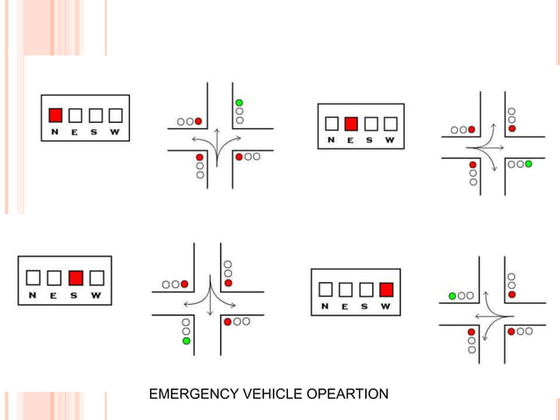
I
WORKING PROCESS

Slide 7
IR SENSOR
Used for object detection using which the system gets an input of the traffic density.
Traffic density is measured as "low, medium and high.
The system adjusts and varies the traffic signal duration for that particular way.
TRAFFIC LIGHTS
The red signal prohibits any traffic from proceeding.
The amber (yellow) light warns that the signals is about to change to red.
The green light allows traffic to proceed in the direction denoted.
Blue LEDs are provide in each lane for the arrival of any emergencyThe system adjusts and varies the traffic signal duration for that particular way.

Slide 8
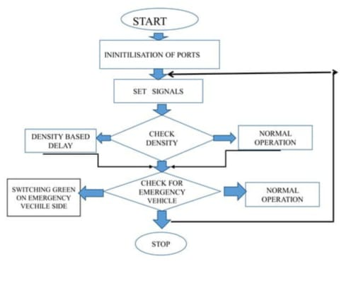
FLOWCHART

Slide 9
COMPONENTS
PIC16F877A
IR SENSOR
LED
RF MODULE

